Slide 1
Social Media Analytics +
Strategic Plan Emily Kranking Strategic Communications + Advocacy Fellow DC Developmental Disabilities Council Public Meeting 9.23.2021

Slide 2
Our Social Media Platforms
Facebook
Twitter
Instagram
YouTube
LinkedIn
LinkTree (NEW!)

Slide 3
Current Analytics Applications
Hootsuite: An analytics website that tracks your popularity on any social media platform, who you attract, and how. It tracks up to the time you join Hootsuite.
Audiense: An analytics website that tracks your popularity on Twitter and how active you were. You get e-mails the following day on how you did the day before.

Slide 4
What Are We Measuring?
Likes: The number of times when people like our original post.
Comments: The number of times when people put a comment on one of our posts.
Shares: The number of times when people reposted our original posts.
Mentions: Accounts who mention you in their posts
Followers: The number of people following your page.
Page views: The number of times each of your Pages' features (Timeline, About, Photos, etc.) have been viewed.

Slide 5
What Are We Measuring? (Cont.)
Total reach: The daily number of users who have seen any content associated with us. Separate analyzes are available for posts and pages.
Post clicks: The number of times when users click on a post.
Post reach: The total number of people who have seen your posts.

Slide 6
Lessons Learned So Far
Our multi-post campaigns like #MeetTheDDC and #AutismAcceptanceMonth were the most successful with our audience.
Posts with statistics or other disability-related facts are also successful at engaging our audience

Slide 7
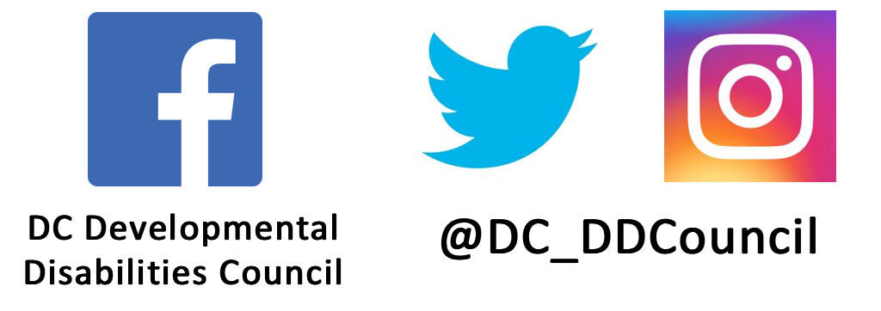
What can you do to help us in our communications?
Follow our pages
Give us good resources or news that are worth posting
Spread and comment on our posts
Connect us with people we can highlight on our social media

Slide 8
Where To Go From Here
Strategize ideas for themes for community engagement posts, such as council members and those who we work with for services and behind the scenes.
Create and conceptualize our own fact posts.
Continue posting local and national news articles. As a Developmental Disabilities Council, it is vital to inform our followers what is happening in DC and the nation.

Slide 9
Why This Matters
Social media use has increased over the last decade and has been adapted into regular life and communication.
It is essential to use social media to connect with the D.C. community and our colleagues.
For some people with disabilities, social media is one of the most accessible ways to get local and regional news.
It's essential to give out government and emergency news, such as COVID-19 updates within the last year.

Slide 10
Questions?
Emily Kranking
Strategic Communications + Advocacy Fellow emily.kranking@dc.gov

