Slide 1
FY24 Budget – PROPOSED
Alison Whyte
Executive Director
DC Developmental Disabilities Council

Slide 2
Agenda
FY24 Budget – PROPOSED
Funding Source
Budget Addendum
Timeline
Summary
Vote

Slide 3
Timeline
FY 2022 and 2023
Estimated from FY22 and FY23 Carryover $175824.03
FY 2024 $527,570
Anticipated FY24 Federal Allotment
FY 2024
Total Available
$703,394.03

Slide 4
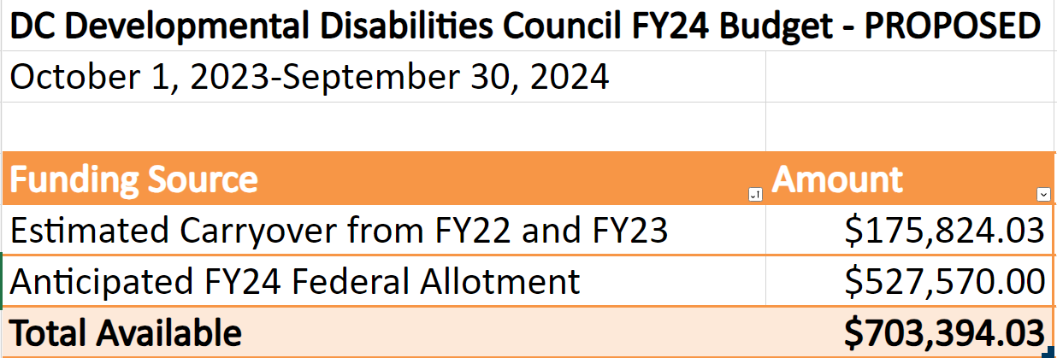
FY24 Budget – PROPOSED
Funding Source

Slide 5
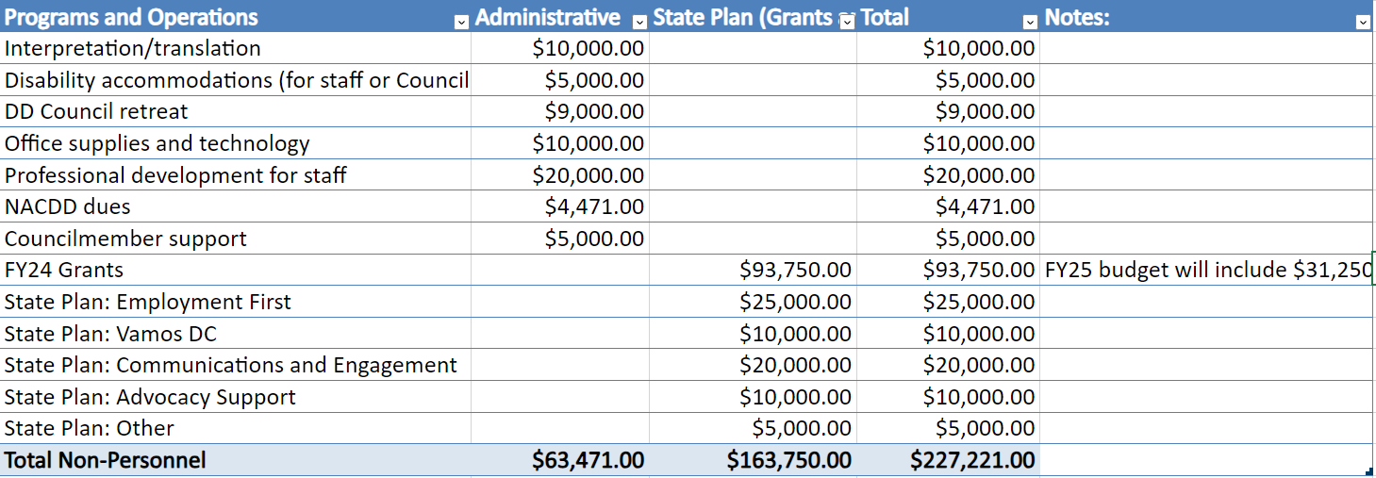
Areas of Growth Programs and Operations

Slide 6
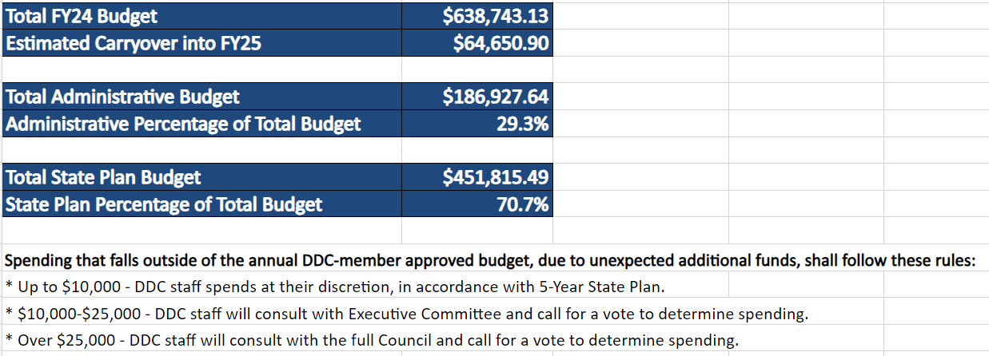
Total FY24 Budget

Slide 7
Supplemental Grants Budget

Slide 8
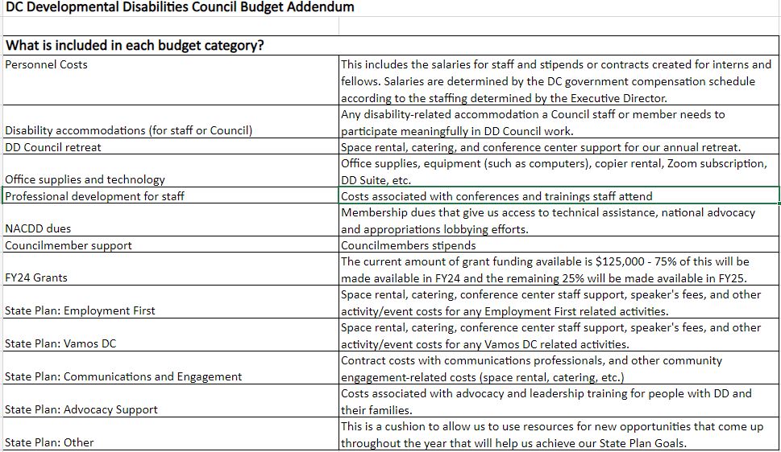

Slide 9
Thank you
Alison Whyte
Executive Director
DC Developmental Disabilities Council

